Slide 1


Slide 2

EXECUTIVE SUMMARY
Problem Statement: Women in Agri-Business, especially farmers & market vendors struggle to connect to markets beyond their regions, and fail to sell their products at competitive market rates due to exploitative middlemen.
Solution: A Digital Market Place that connects Agri-Businesses directly to big corporate clients, and enables them to make transactions in a safe, efficient & transparent way.
MVP Funding: $ 3000 to develop & launch a Progressive Web Application
Technologies Used: Python Flusk for backend, React.js for frontend , Github, Slack & Zoom for collaboration
Mojaloop: Payment switch for secure payments across different accounts with Escrow security feature
Level One principles: Pricing transparency, User friendly interface design, Notifications, Data Privacy, Secure payment transactions

Slide 3
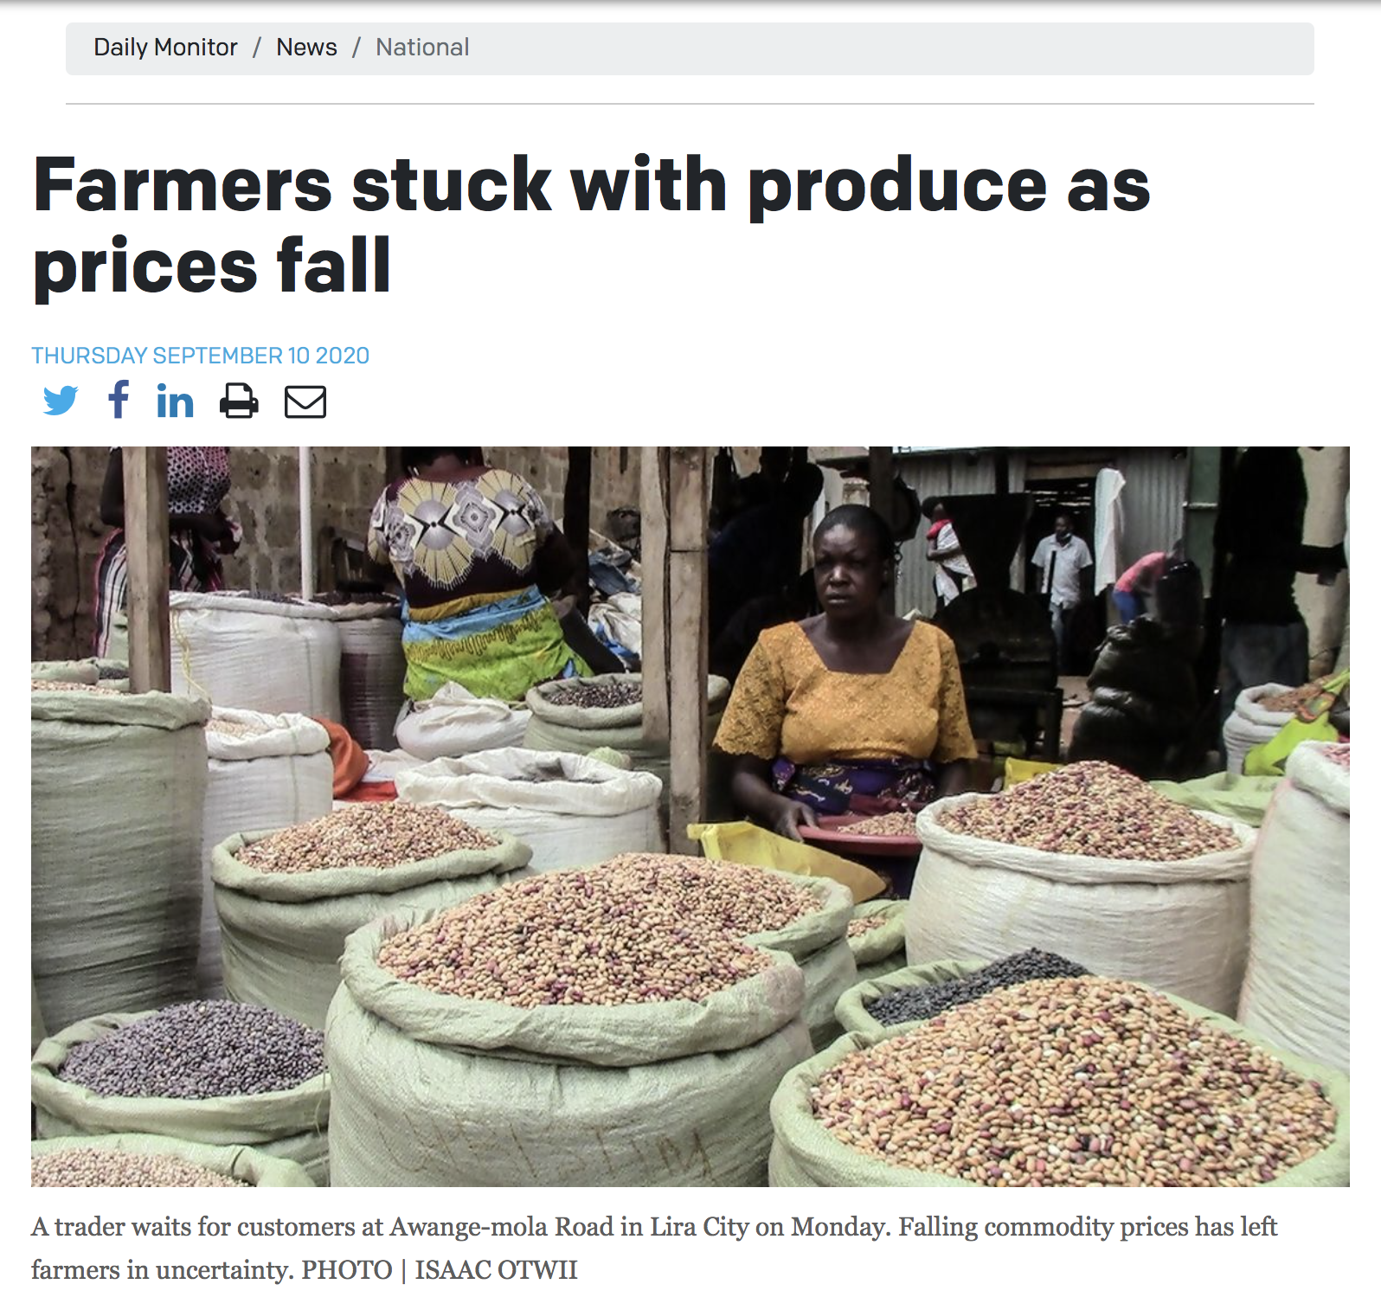
THE PROBLEM
Connecting to markets beyond their physical regions
No safeguard measure for market prices & exploitative middlemen
Pressure to sell as much of their stock within a limited time due to the perishable nature of their produce
Notes:
Women in Agri-Business often find it difficult to connect to market their products and directly to markets beyond their regions….
No safeguard measure for market prices
Due to the perishable nature of their produce, they face pressure to sell as much of their stock within a limited time and can be forced to sell for less or deal with exploitative middlemen to avoid making losses.

Slide 4
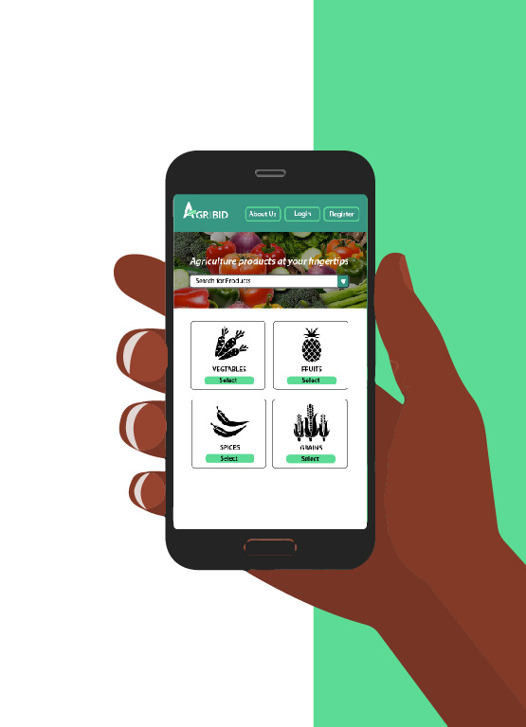
SOLUTION DESIGN
AgriBid is a digital market place that showcases agricultural products for sale. Users can register as buyers or suppliers, and bid to supply bulk orders of produce and other products.
Our solution can be used by restaurants, hotels, beverage factories and other companies that regularly purchase bulk orders from farmers or market vendors
We aim to help Agri-Businesses access larger markets by connecting them directly to big corporate clients, and enables them to make transactions in a safe, efficient & transparent way.
TARGET MARKET
Suppliers:
Farm Managers
Market Vendors
Female in Agri-Business
Buyers:
Restaurants
Hotels
Beverage Factories
Notes:
Aggrigating quantity of products
• Famers will plan their seasons according to the market needs.
End users clients
Clients are able to shop from different farmers hence they always have ready supply.
Cashless transactions can be easily tracked thought the process until client is satisfied with the
quality of the produce delivered
Target Market

Slide 5
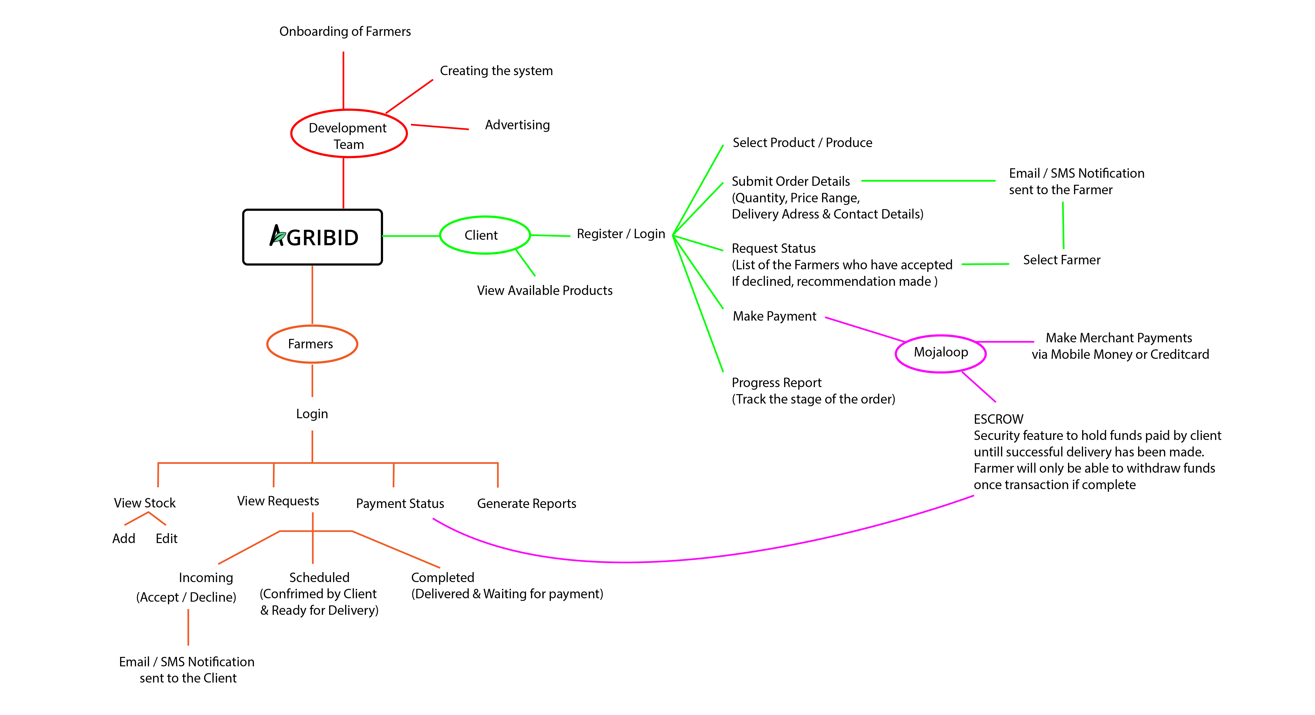
MIND MAP & SCOPE OF PROJECT

Slide 6
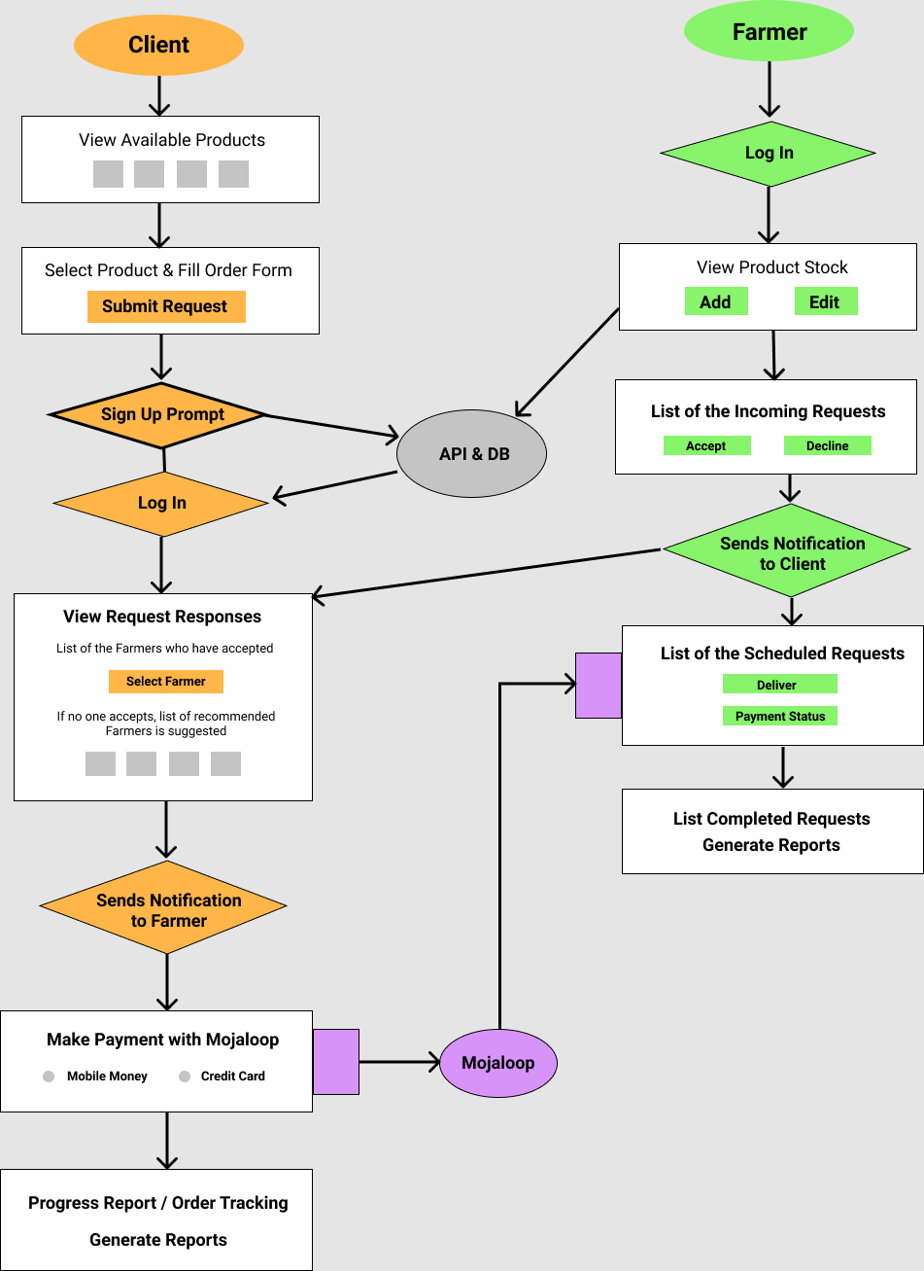

SYSTEM FLOW
& LEVEL 1 PRINCIPLES
Pricing Transparency:
Cost breakdown overview before payments
User interface design user friendly:
Use of icons instead of heavy images, Responsive layout & Progressive web app Clients can shop for products without having to login first
Notifications:
Users are notified whenever requests
& transactions are made
Data Privacy:
Login access to dashboard Security:
ESCROW holding accounts
Notes:
System flow chart to show how the application works
Level 1 Principles – end user experience

Slide 7

MOJALOOP
& INTEROPRABILITY
Payment switch that enables secure payment with mobile money or credit cards from different banks.
Escrow security feature to hold clients funds until farmer has completed the delivery, before transferring the funds into the farmers account
Clients will be able to view and track transactions

Slide 8



BUSINESS PLAN & ROADMAP
COST OF IMPLEMENTATION
TIMESCALE
SUSTAINABILITY
Developers
Utilities
User test research
Web hosting
Google Playstore Listing
Registering licenses
Marketing & Incentives
Taxes
1 Year Projections
Total Users = 3,720
Total Transactions = 215,000,000
Total Revenue = 4,010,000
Total Expenses = 35,675,000
Estimate to Break-Even in 5 Years
4 weeks - Finalize Product Development
For every transaction made, a 0.5 % fee is deducted off as service fee from the client.
Partner with agriculture input companies to offer credit to women on our platform when purchasing inputs eg. seeds etc
Partner with insurance companies to protect value of products sold & delivered through the platform
2 weeks - Pilot user testing
& research
2 weeks - Pilot user testing & research
1 week - Obtaining business licenses & web hosting
1 week - Launch Marketing Incentives
GO TO MARKET !
USSD Menu for basic functionality
Notes:
Ongoing Costs & One Time Costs for approx.18 months =
Average transaction value of 2 million + 25% estimated growth per month = Projected Revenue of 7.5 million in 1st year
2,300,000
Monthly Cost Estimate
500,000
Average Revenue Per Month
Projected Break Even Point

Slide 9
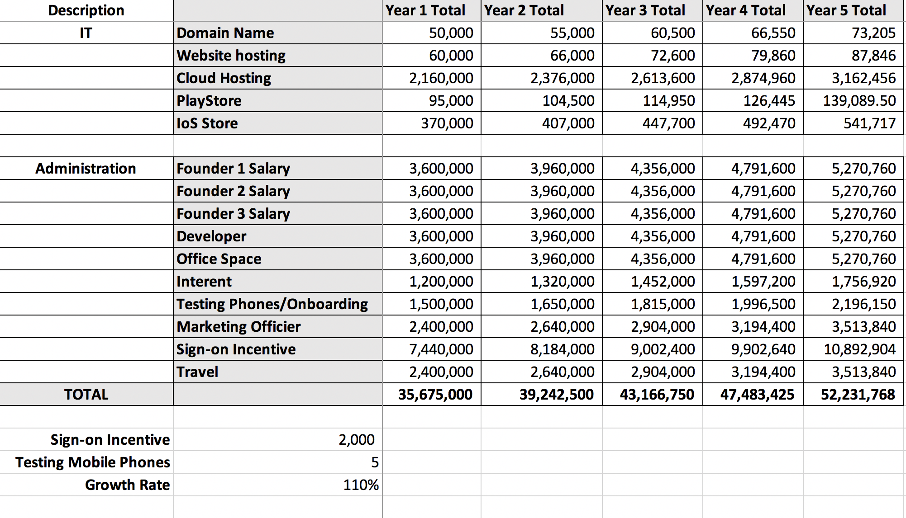
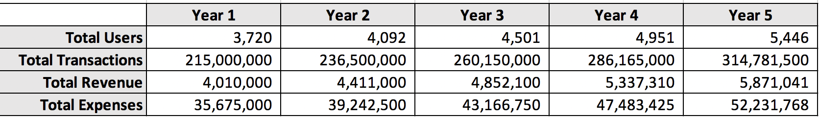
REVENUE PROJECTIONS
ESTIMATED COST OF IMPLEMENTATION

Slide 10

MVP DEMO
VIEW OUR PROTOTYPE:
https://marvelapp.com/prototype/7bhf5fa/screen/72748036
TEST OUR ENDPOINTS
Adding a product to the database as a farmer: https://agribidtech.herokuapp.com/api/v1/clientRequest
Registering a user: https://agribidtech.herokuapp.com/api/v1/auth/signup
View users: https://agribidtech.herokuapp.com/api/v1/users
Client Request: https://agribidtech.herokuapp.com/api/v1/clientRequest
TEST OUR MINIMAL VIABLE PRODUCT:
Frontend Repo: https://github.com/VivianDoreen/agribid-frontend
Backend Repo: https://github.com/VivianDoreen/agribid
Notes:
SUPPLIER USER JOURNEY:
Login to Supplier Dashboard
Upload agricultural products & view stock list
View incoming, scheduled & completed requests
Accept or decline client requests
View payments received & transfer funds into account
BUYER USER JOURNEY:
View available products & place an order
Register & Login to Buyer Dashboard
View & select suppliers who have responded to their request
Payment with mobile money or credit card
Review order status & confirm orders received to complete transaction

Slide 11

MEET THE DEVELOPMENT TEAM
Maria Musimenta
Team Leader
Liz Kamugisha
UI / UX Designer
Vivian Doreen Nabulo
Product Developer
Famious Orishaba
Cyber Security

Slide 12


